Slide 1

Chancellor Hitler: The Rise of Evil

Slide 2
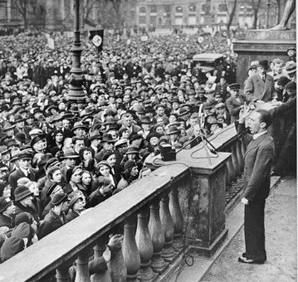
Support for the Nazi Party
The Nazis used propaganda to gather the support of the people.
Joseph Goebbels was in charge of propaganda, using every method he could to get maximum publicity for the Hitler.
He made records, films, displayed posters and flags, held mass rallies where Hitler would speak.
The Nazis also used the SA to gain support, beating up Communists and breaking up their meetings.

Slide 3
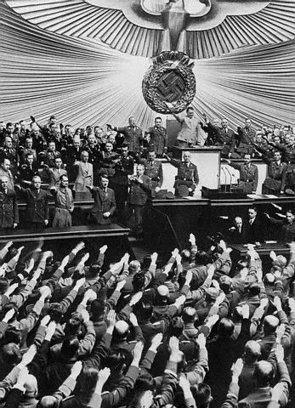
1932 and 1933
As the largest party in the Reichstag Hitler demanded to be made Chancellor.
Hindenburg refused to give him the post. He did not want the power of the Reichstag to be given to a new party with its violent political methods.
Hindenburg allowed present Chancellor Franz Von Papen to stay in office, using his powers to make Papen’s decisions law. Papen only had the support of 97 seats in the Reichstag.

Slide 4
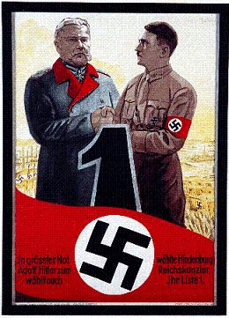
Hitler’s Rise to Power
After the reappointment of Papen in November:
Kurt von Schleicher one of Hindenburg's advisors, told him that the army would not support Papen staying in office, threatening a general strike, even civil war.
Hindenburg had to get rid of Papen, appointing Schleicher as Chancellor.
Schleicher lasted 57 days, the Reichstag would not support his decisions either.
Hindenburg had no choice but to appoint Hitler Chancellor, this occurred on 30th January 1933.

Slide 5
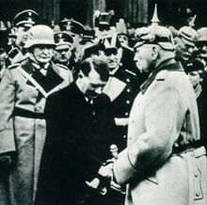
Hitler’s Rise to Power
While Hitler seemed on his way to take control of Germany there were some obstacles in his way.
Firstly, Germany was a democracy, laws could only be made if the Reichstag supported them. As more than half the government was made up of parties who opposed Hilter, making it difficult legalise his policies.
Secondly, Hitler owed his position to Hindenberg, who could easily make him resign if he disagreed with Hitler’s decisions.
So, Hitler had to be careful about the careful about how he got rid of his opponents.

